Slide 1
Final Engagement
Attack, Defense & Analysis of a Vulnerable Network

Slide 2
Table of Contents
This document contains the following resources:
Network Topology & Critical Vulnerabilities
Alerts Implemented
Hardening
Implementing Patches

Slide 3

Network Topology
& Critical Vulnerabilities
‹#›

Slide 4
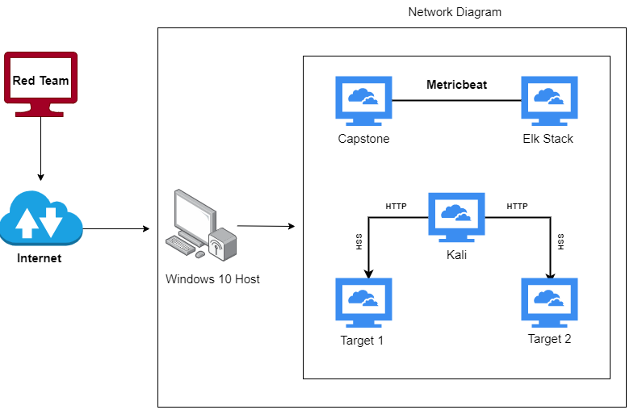
Network Topology
Network
Address Range: 192.168.1.0/24
Netmask:
Gateway: 192.168.1.1
Machines
IPv4: 192.168.1.110
OS: Debian
Hostname: target1
IPv4: 192.168.1.115
OS: Debian
Hostname: target2
IPv4: 192.168.1.100
OS:Ubuntu
Hostname: Kibana/Elasticsearch
IPv4: 192.168.1.105
OS:Ubuntu
Hostname: Capstone
IPv4: 192.168.1.90
OS:Debian
Hostname: Kali

Slide 5
Critical Vulnerabilities: Target 1
Our assessment uncovered the following critical vulnerabilities in Target 1.
Vulnerability | Description | Impact
User michael had weak password | Password was his User ID | Easily exploited login credentials to logon to the Wordpress server over SSH
Wordpress Config File had invalid permissions | wp-config.php was world readable and contained the DB login credentials | Attacker was able to read hashed passwords in the WORDPRESS database.
Weak password in Wordpress database | Ran John the Ripper against hashed passwords and cracked Steven’s | Access to the admin pages for the Wordpress server.
Server was vulnerable to wpscan | Provided user names | Provided user names

Slide 6
Alerts Implemented
‹#›

Slide 7
Excessive HTTP Errors
Summarize the following:
Which metric does this alert monitor? This alerts when 400 or more login failures happen in 5 minute period.
What is the threshold it fires at? 400 login failures in a 5 min period
Provide a screenshot of the alert in action.

Slide 8
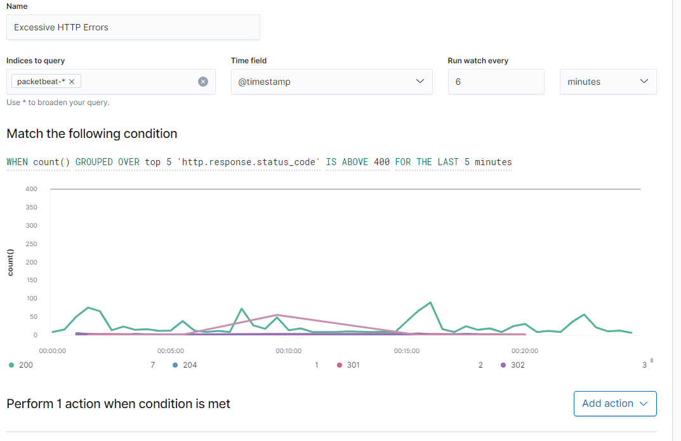
Screen Shot

Slide 9
CPU Usage Monitor
Summarize the following:
Which metric does this alert monitor? This monitors CPU usage on the Target 1 Server
What is the threshold it fires at? 50% CPU usage
Provide a screenshot of the alert in action.

Slide 10
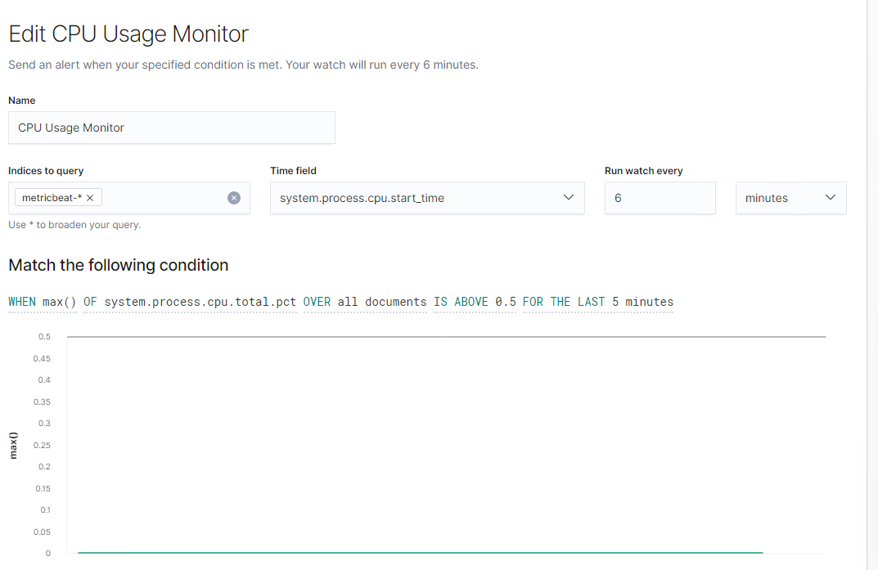
Screen Shot

Slide 11
HTTP Request Size Monitor
Summarize the following:
Which metric does this alert monitor? This monitors the total request packet size for requests in 1 minute. It indicates if a potential DDOS attack or brute force attack is taking place.
What is the threshold it fires at? Total Packet size over 3500 bytes in 1 minute.
Provide a screenshot of the alert in action.

Slide 12
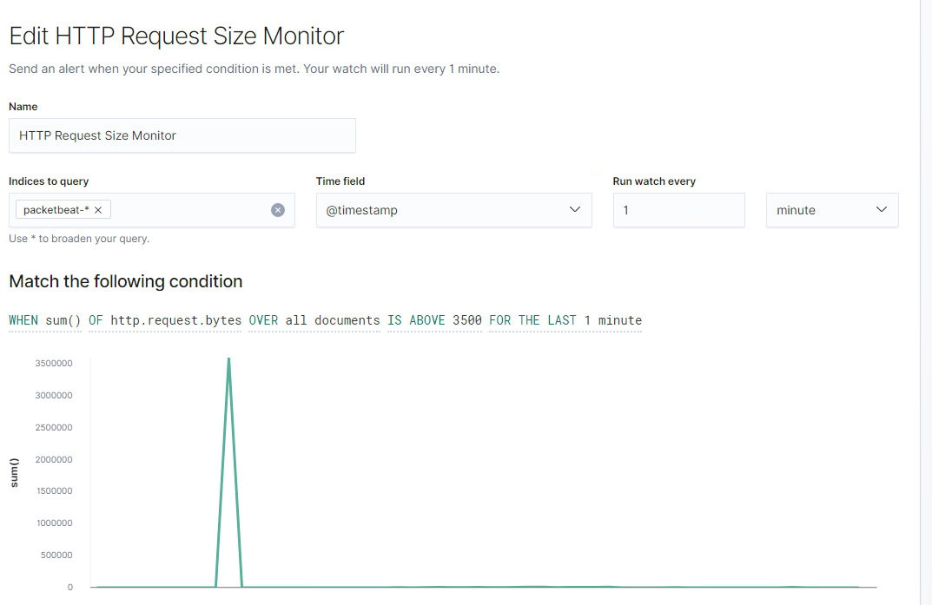
Screen Shot

Slide 13
Hardening
‹#›

Slide 14
Hardening Against [Weak System Password] on Target 1
Explain how to patch Target 1 against Vulnerability 1.
To address weak passwords, force a password policy that requires the use of strong passwords and password reset policy.

Slide 15
Hardening Against [Invalid Permissions on Config] on Target 1
Explain how to patch Target 1 against Vulnerability 2. Include:
Change the permissions of the wordpress directory to prevent unauthorized access to the wordpress config files.
chmod 700 /var/www/html/wordpress/*

Slide 16
Hardening Against [Weak Application Password] on Target 1
Explain how to patch Target 1 against Vulnerability 3. Include:
Require strong passwords at the database level for authentication.

Slide 17
Hardening Against [WPSCAN Vulnerability] on Target 1
Explain how to patch Target 2 against Vulnerability 1. Include:
Either upgrade to the latest version of wordpress, or use a more secure content management system.

Slide 18
Implementing Patches
‹#›

Slide 19
Implementing Patches with Ansible
Playbook Overview
Ansible could be used to update Word Press, Apache and the OS.
An example ansible playbook task to update the WP Core system could look like:
- name: Update WordPress Core (Major version)
command: "{{ wpclipath }} core update"
when: major is defined
args:
chdir: '{{ projects[inventory_hostname].blog_folder }}'

Slide 20
Implementing Patches with Ansible
Playbook Overview
An example ansible playbook task to update Ububtu and all packages could look like:
- name: Update apt-get repo and cache
apt: update_cache=yes force_apt_get=yes cache_valid_time=3600

